Slide 1
Language Modeling
Hung-yi Lee
李宏毅
Notes:
Can I walk more?
Talk about Tomas Mikolo’s work

Slide 2

Language modeling
Language model: Estimated the probability of word sequence
Word sequence: w₁, w₂, w₃, …., w_{n}
P(w₁, w₂, w₃, …., w_{n})
Application: speech recognition
Different word sequence can have the same pronunciation
Application: sentence generation
If P(recognize speech)
>P(wreck a nice beach)
recognize speech
or
wreck a nice beach
Output = “recognize speech”
Notes:
wreck
破壞；損害；使受挫
Not only speech recognition, but also translation

Slide 3
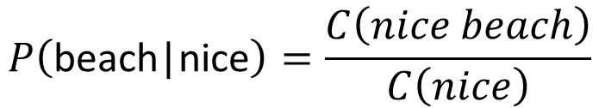
N-gram
P(“wreck a nice beach”)
=P(wreck|START)P(a|wreck)P(nice|a)P(beach|nice)
How to estimate P(w₁, w₂, w₃, …., w_{n})
Collect a large amount of text data as training data
However, the word sequence w₁, w₂, …., w_{n} may not appear in the training data
N-gram language model: P(w₁, w₂, w₃, …., w_{n}) = P(w₁|START)P(w₂|w₁) …... P(w_{n}|w_{n-1})
E.g. Estimate P(beach|nice) from training data
It is easy to generalize to 3-gram, 4-gram ……
2-gram
$$P\left(\text{beach}\text{|}\text{nice}\right)=\frac{C\left(nice beach\right)}{C\left(nice\right)}$$
Count of “nice beach”
Count of “nice”

Slide 4
NN-based LM
Training:
潮水
Neural
Network
就
Collect data:
退了
潮水 退了 就 知道 誰 …
不爽 不要 買 …
公道價 八萬 一 …
………
退了
Neural
Network
知道
就
Minimizing cross entropy
就
Neural
Network
誰
知道
Notes:
What can it do? Application?

Slide 5
NN-based LM
P(“wreck a nice beach”)
=P(wreck|START)P(a|wreck)P(nice|a)P(beach|nice)
P(b|a): the probability of NN predicting the next word.
P(next word is “wreck”)
P(next word is “a”)
P(next word is “nice”)
P(next word is “beach”)
Neural
Network
Neural
Network
Neural
Network
Neural
Network
1-of-N encoding of “START”
1-of-N encoding of “wreck”
1-of-N encoding of “a”
1-of-N encoding of “nice”

Slide 6
RNN-based LM
Collect data:
潮水 退了 就 知道 誰 …
不爽 不要 買 …
公道價 八萬 一 …
………
Training
潮水
退了
就
知道
……
……
……
begin
潮水
退了
就
Notes:
There are many benefit for RNN over the conventional n-gram LM
Due to time limitation, I am not going to talk about that
RNN-based LM is the state-of-the-art language modeling technique
Model long-term information
Can also consider LSTM
Long term:
each bi-gram is different
depended on the context
very long -> to the beginning

Slide 7
RNN-based LM
Modeling long-term information
People also use Deep RNN or LSTM
To compute P(w₁, w₂, w₃, …., w_{n}) by RNN
P(w₁, w₂, w₃, …., w_{n})
=P(w₁)P(w₁|w₂)P(w₃|w₁,w₂) …… P(w_{n}|w₁,w₂ … w_{n-1})
P(w₁)
P(w₂|w₁)
P(w₃|w₁,w₂)
P(w₄|w₁,w₂,w₃)
……
……
……
begin
w₁
w₂
w₃
Notes:
There are many benefit for RNN over the conventional n-gram LM
Due to time limitation, I am not going to talk about that
RNN-based LM is the state-of-the-art language modeling technique
Model long-term information
Can also consider LSTM
Long term:
each bi-gram is different
depended on the context
very long -> to the beginning

Slide 8
Challenge of N-gram
The estimated probability is not accurate.
Especially when we consider n-gram with large n
Because of data sparsity
Large model, not sufficient data
The dog ran ……
The cat jumped ……
Training Data:
P( jumped | the, dog ) = 0
0.0001
Give some small probability
P( ran | the, cat ) = 0
0.0001
This is called language model smoothing.

Slide 9

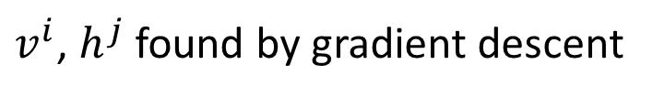


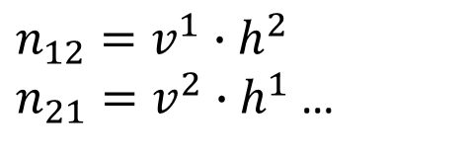


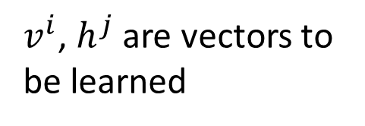

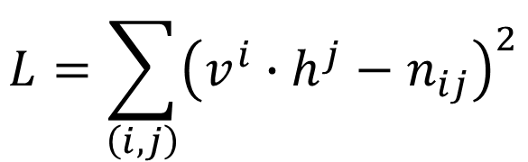


Matrix Factorization
Recommendation System:
History as customer, vocabulary as product ……
$$h^{2}$$
history
 | dog | cat | …… | child
ran | 0.2 | 0.3 |  | 0.1
jumped | 0 | 0.2 |  | 0.1
cried | 0 | 0 |  | 0.3
laughed | 0 | 0 |  | 0.3
……
$$h^{1}$$
$$v^{1}$$
$$n_{11}$$
$$v^{2}$$
$$n_{22}$$
Vocabulary
$$v^{3}$$
$$v^{4}$$
Not observed
P( jumped | cat )
Minimizing
$v^{i}$, $h^{j}$ are vectors to be learned
$$L=\sum_{\left(i,j\right)}{{\left(v^{i}∙h^{j}−n_{ij}\right)}^{2}}$$
$n_{12}=v^{1}∙h^{2}$
$n_{21}=v^{2}∙h^{1}$ …
$v^{i}$, $h^{j}$ found by gradient descent

Slide 10
Matrix Factorization
Recommendation System:
History as customer, vocabulary as product ……
$$h^{2}$$
history
 | dog | cat | …… | child
ran | 0.2 | 0.3 |  | 0.1
jumped | 0 | 0.2 |  | 0.1
cried | 0 | 0 |  | 0.3
laughed | 0 | 0 |  | 0.3
……
$$h^{1}$$
$$v^{1}$$
$$n_{11}$$
$$v^{2}$$
$$n_{22}$$
Vocabulary
$$v^{3}$$
$$v^{4}$$
Not observed
P( jumped | cat )
History “dog” and “cat” can have similar vector h^{dog} and h^{cat}
If v^{jumped} $∙$ h^{cat} is large, v^{jumped} $∙$ h^{dog} would be large accordingly.
Even if we have never seen “dog jumped …”
Smoothing is automatically done.

Slide 11



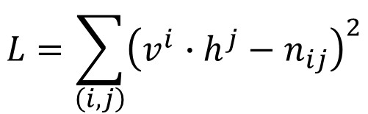


Matrix Factorization
$$L=\sum_{\left(i,j\right)}{{\left(v^{i}∙h^{j}−n_{ij}\right)}^{2}}$$
target
$$h^{cat}$$
$$v^{ran}$$
0.2
cat
0
ran
P(ran|dog)
softmax
Cross Entropy
dog
1
cried
0.0
$$h^{dog}$$
$$h^{dog}$$
$$v^{cried}$$
P(cried|dog)
history
vocabulary
from training data
1-of-N encoding
Consider it as a NN ……

Slide 12






RNN-based LM
$$w_{t+1}=1$$
(0 otherwise)
ran
cried
If we use 1-of-N encoding to represent the history, history cannot be very long.
$$v^{ran}$$
$$v^{cried}$$
h^{t}
h⁰
f
h¹
f
f
……
$$w_{1}$$
$$w_{2}$$
……
$$w_{t}$$

Slide 13
Class-based Language Modeling
class 1: Animal
class 2: Verb
class 3: Function word
dog
ran
jumped
the
cat
bird
walk
by
a
W = “w₁ w₂ w₃”
C(w_{i}): class of word w_{i}
P(W) = P(w₁|START) P(w₂|w₁) P(w₃|w₂)
P(W) = P(C(w₁)|START) P(C(w₂)|C(w₁)) P(C(w₃)|C(w₂))
X P(w₁|C(w₁)) P(w₂|C(w₂)) P(w₃|C(w₃))

Slide 14
Class-based Language Modeling
class 1: Animal
class 2: Verb
class 3: Function word
dog
ran
jumped
the
cat
bird
walk
by
a
W = “the dog ran”
F
A
V
P(W) = P(F|START) P(A|F) P(V|A)
X P(the|F) P(dog|A) P(ran|V)
P( class i | class j ) and P(word w| class i ) are estimated from training data.

Slide 15
Class-based Language Modeling
P( class i | class j ) and P(word w| class i ) are estimated from training data.
Training data
the dog ran
the cat jumped
F
A
V
F
A
V
W = “the cat ran”
F
A
V
P(ran|cat) is zero given the training data
However, P( Verb | Animal ) is not zero

Slide 16
Soft Word Class
How to determine the classes of the words?
1-of-N Encoding
Word Embedding
apple = [ 1 0 0 0 0]
W^{e}
cat
bag = [ 0 1 0 0 0]
rabbit
run
cat = [ 0 0 1 0 0]
jump
dog
dog = [ 0 0 0 1 0]
W^{e}
tree
flower
elephant = [ 0 0 0 0 1]

Slide 17
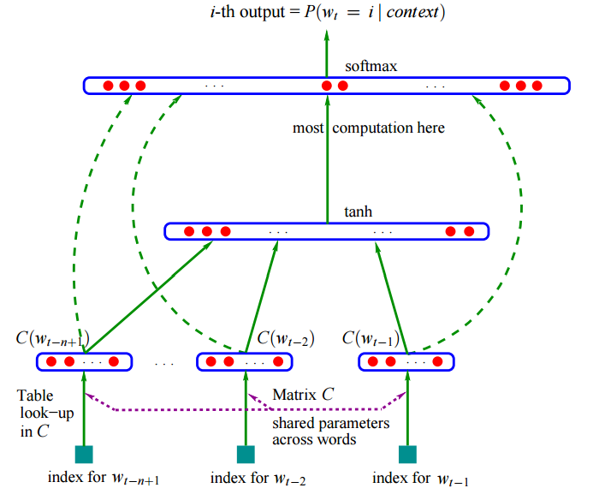
Bengio, Y., Ducharme, R., Vincent, P., & Jauvin, C. (2003). A neural probabilistic language model. Journal of machine learning research, 3(Feb), 1137-1155.

Slide 18






RNN-based LM
ran
cried
+ Embedding Layer
$$v^{ran}$$
$$v^{cried}$$
h^{t}
$$C\left(w_{t+1}\right)$$
h⁰
f
h¹
f
f
……
……
$$C\left(w_{1}\right)$$
$$C\left(w_{2}\right)$$
$$C\left(w_{t}\right)$$
W^{e}
……
W^{e}
W^{e}
$$w_{1}$$
$$w_{2}$$
……
$$w_{t}$$

Slide 19
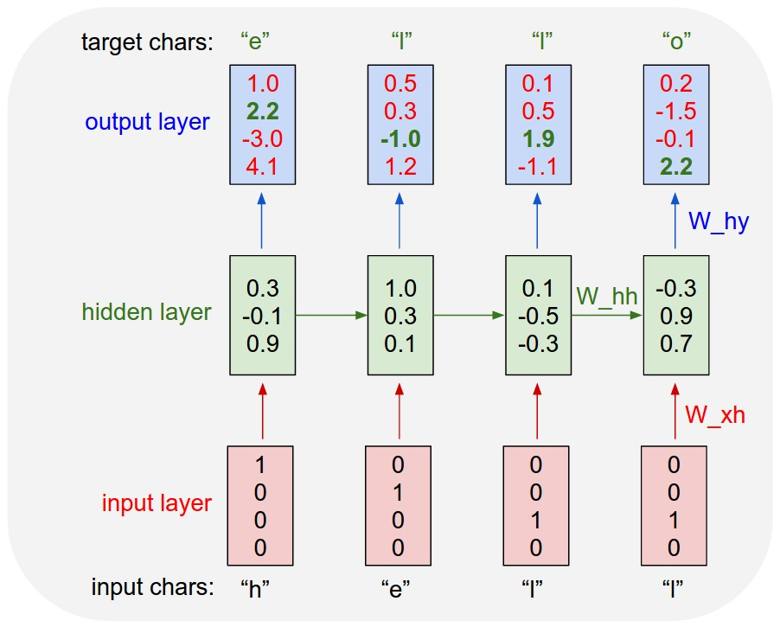
Character-based LM
Source of image: http://karpathy.github.io/2015/05/21/rnn-effectiveness/

Slide 20
Long-term Information
$$P_{LSTM}\left("\}"|history\right)−P_{N−gram}\left("\}"|history\right)$$
Andrej Karpathy, Justin Johnson, Li Fei-Fei, Visualizing and Understanding Recurrent Networks, https://arxiv.org/abs/1506.02078

Slide 21
y^{t}
LSTM
c^{t}
c^{t-1}
h^{t}
h^{t-1}
x^{t}
-1 is red
+1 is blue

Slide 23
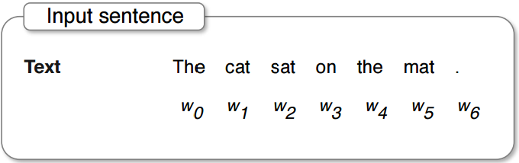
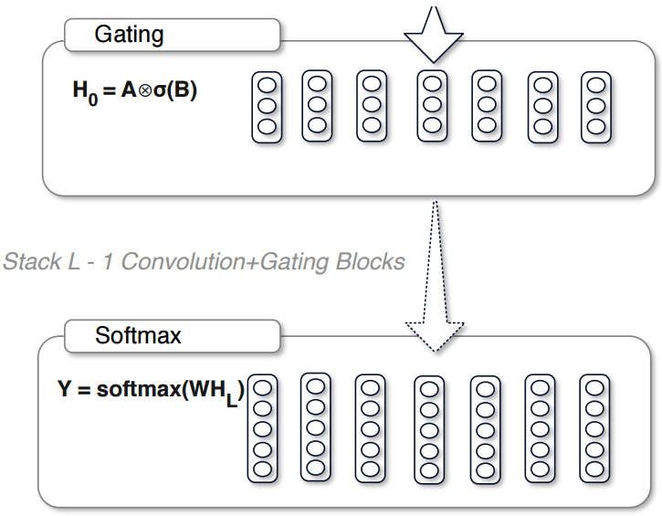
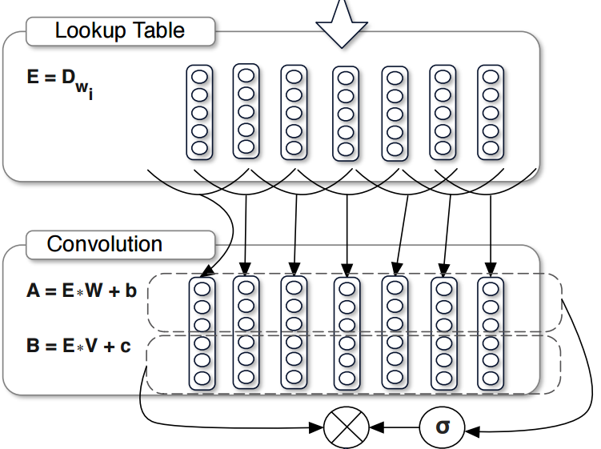
CNN for LM
Yann N. Dauphin, Angela Fan, Michael Auli, David Grangier, Language Modeling with Gated Convolutional Networks, https://arxiv.org/abs/1612.08083

Slide 24
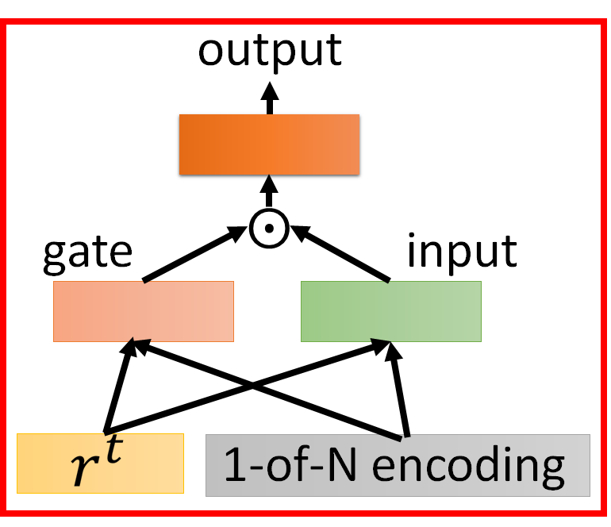
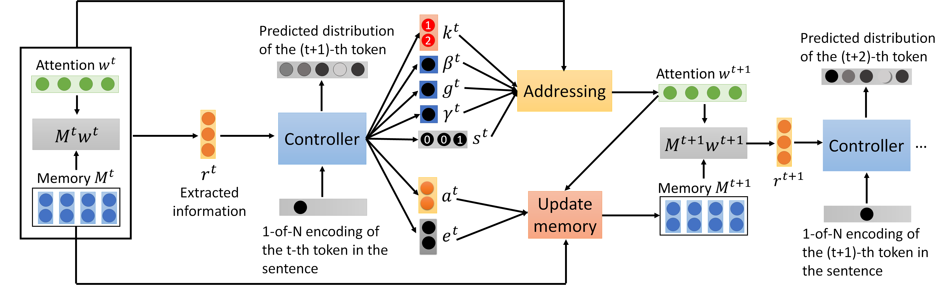
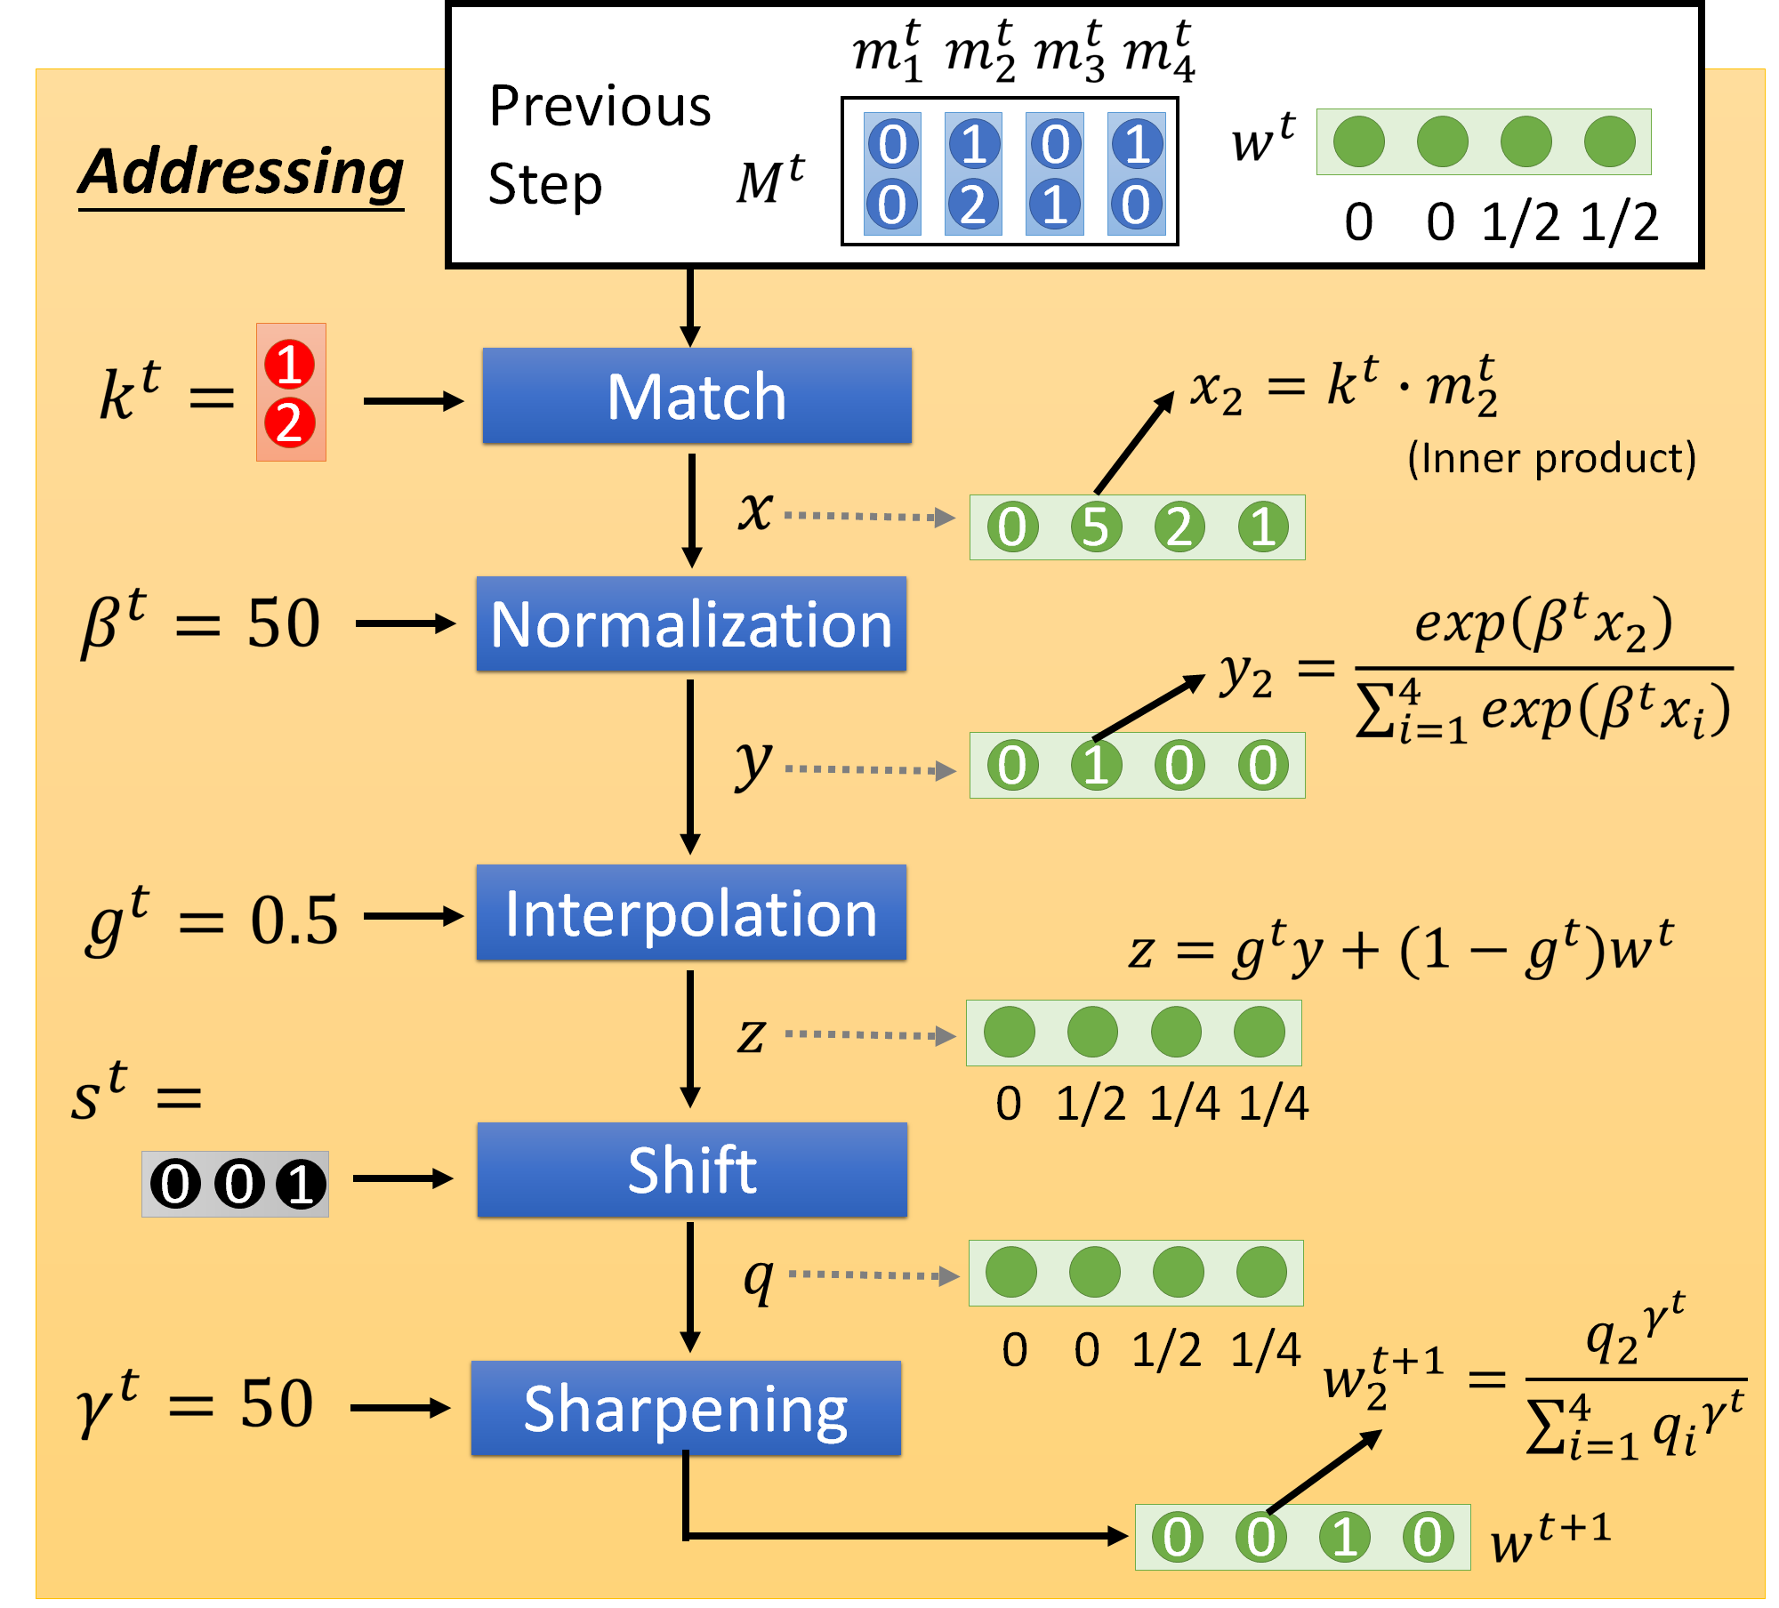
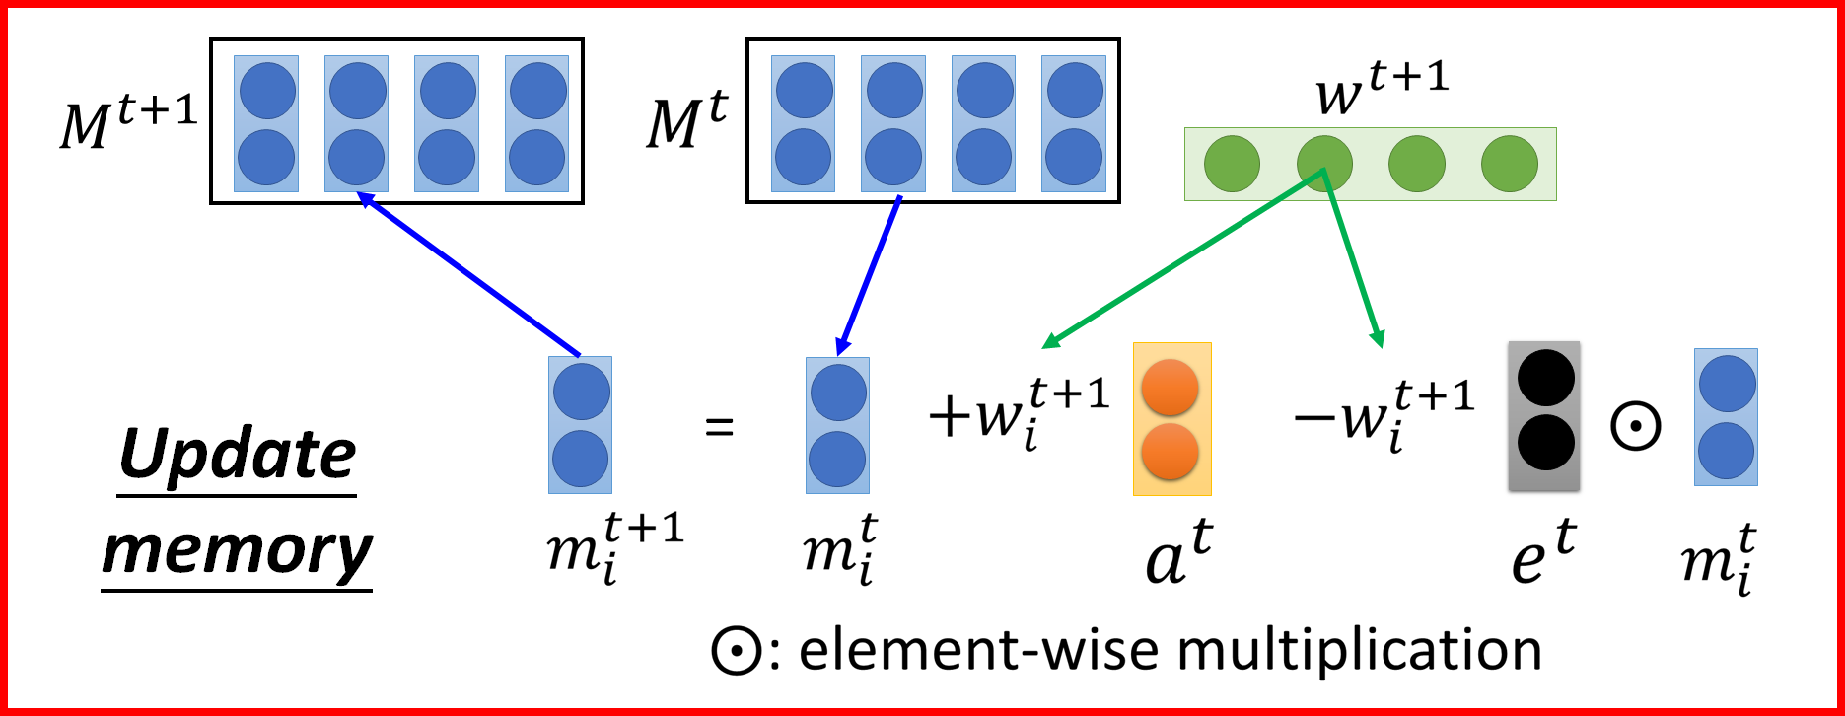
Neural Turing Machine for LM
Wei-Jen Ko, Bo-Hsiang Tseng, Hung-yi Lee, “Recurrent Neural Network based Language Modeling with Controllable External Memory”, ICASSP, 2017

Slide 25
For Large Output Layer
Factorization of the Output Layer
Mikolov Tomáš: Statistical Language Models based on Neural Networks. PhD thesis, Brno University of Technology, 2012. (chapter 3.4.2)
http://speech.ee.ntu.edu.tw/~tlkagk/courses/MLDS_2015/NN%20Lecture/RNNLM.ecm.mp4/index.html
Noise Contrastive Estimation (NCE)
X. Chen, X. Liu, M. J. F. Gales and P. C. Woodland, "Recurrent neural network language model training with noise contrastive estimation for speech recognition,“ ICASSP, 2015
B. Zoph , A. Vaswani, J. May, and K. Knight, “Simple, Fast Noise-Contrastive Estimation for Large RNN Vocabularies” , NAACL, 2016
Hierarachical Softmax
F Morin, Y Bengio, “Hierarchical Probabilistic Neural Network Language Model”, Aistats, 2005
Blog posts:
http://sebastianruder.com/word-embeddings-softmax/index.html
http://cpmarkchang.logdown.com/posts/276263--hierarchical-probabilistic-neural-networks-neural-network-language-model

Slide 26
To learn more ……
M. Sundermeyer, H. Ney and R. Schlüter, From Feedforward to Recurrent LSTM Neural Networks for Language Modeling, in IEEE/ACM Transactions on Audio, Speech, and Language Processing, vol. 23, no. 3, pp. 517-529, 2015.
Kazuki Irie, Zoltan Tuske, Tamer Alkhouli, Ralf Schluter, Hermann Ney, “LSTM, GRU, Highway and a Bit of Attention: An Empirical Overview for Language Modeling in Speech Recognition”, Interspeech, 2016
Ke Tran, Arianna Bisazza, Christof Monz, Recurrent Memory Networks for Language Modeling, NAACL, 2016
Jianpeng Cheng, Li Dong and Mirella Lapata, Long Short-Term Memory-Networks for Machine Reading, arXiv preprint, 2016

Slide 27
Acknowledgement
感謝 傅彥禎、楊喻涵 同學發現投影片上的打字錯誤

